Slide 1
Operating System
RTOS or Linux

Slide 2
Requirements
Should help with the mobile streaming part
Accessing files from preloaded memory (ebooks, audiobooks, video lectures) ( 64/128 GB inbuilt memory)
Accessing files from outside through USB Sticks
Easy accessibility and interface
Prospective feature to add: internet accessibility (Not a current goal, something to add in later phase)

Slide 3
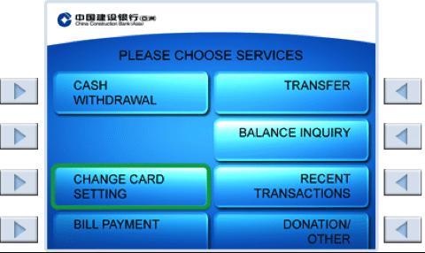
Interface we are planning – Easy enough so anybody can understand and use
Mobile Streaming
Simulations
USB Mode
Audiobooks
Textbooks
Internet?
Videos
Turn Off

Slide 4
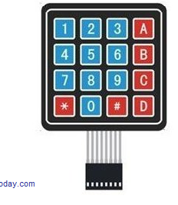
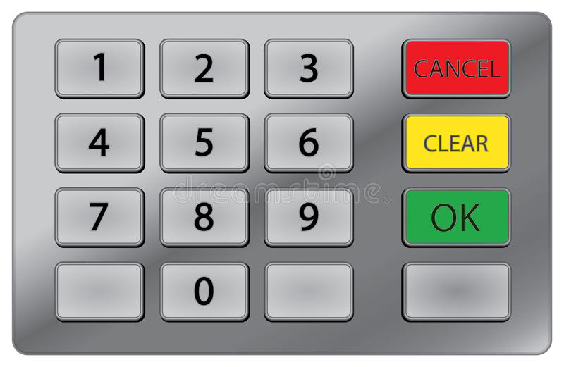
InterfaCe we are planning - Controller
No mouse/Keyboard – Keeping in mind the rough usage in village areas, User Interface would be simple to understand and use – Arshita would elaborate more.

Slide 5
RTOS
Pros | Cons
1. Easy handling of hardware peripheral | 1. Scrcyp is not supported on RTOS (Major issue)
2. Better for embedded system –interrupt handling capacity better than GPOS, although not sure if this function would be beneficial for us. | 2. Can’t add new programs easily
3. GUI, File system everything available easily | 3.
4. Easier to implement (not sure about this)
Shakti: FreeRTOS, Zephyr, eChronos
Vega: FreeRTOS and ZephyrOS

Slide 6
Linux
Pros | Cons
1. Scrcpy supported | 1. Complex handling
2. Tons of open source help and documentation | 2. Abstraction needed at the user end as CLI is difficult to understand
3. New programs easy to add
4. Lots of open source educational material can be added over the time.
5. For those who know how to use Linux, can go over the abstraction layer and use its many functionalities.
Shakti: Linux, Sel4
Vega: Linux ( Supports device drivers for GPIO, UART, SPI, I2C, Ethernet etc.)

